Slide 1
Virginia Presidential Election Prediction
Virginia 2 Good
Thomas Borklund
Michael McDonald
Jorge Suárez-Marill
Chaoran Wang
Yang Xu

Slide 2

Overview
Reasoning
Data Sets
Methods
Prediction

Slide 3

Reasoning
Unique election
Trump and Clinton scandals
Historical: First female president
Box Quote:
“All models are Wrong, some models are useful”

Slide 4


Data Sets
Federal Election Commission
Infoplease
United Census Bureau
Fivethirtyeight.com
2016 Election Forecast

Slide 5
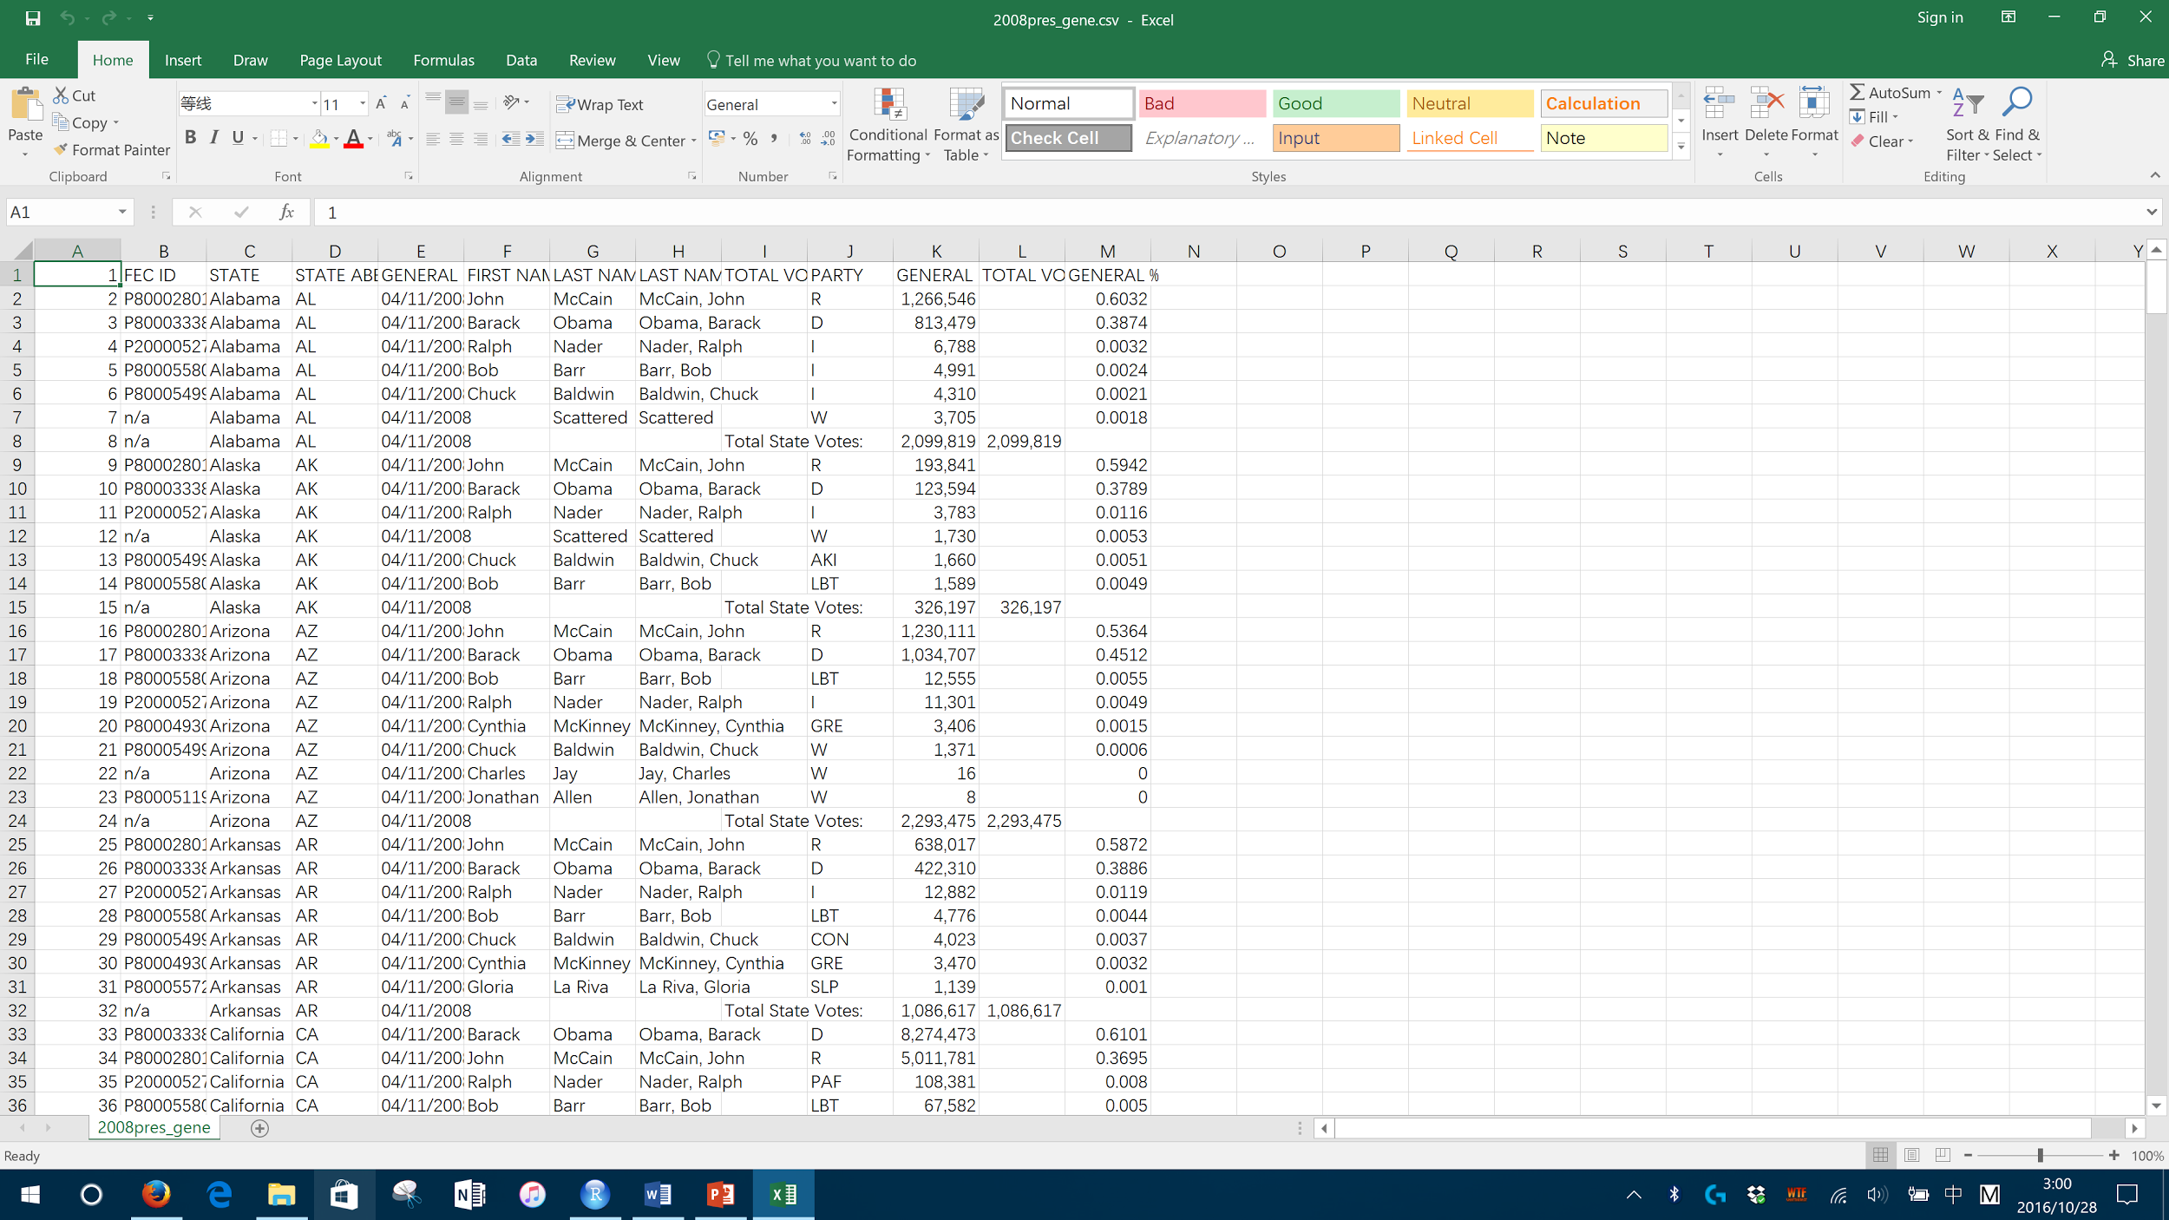
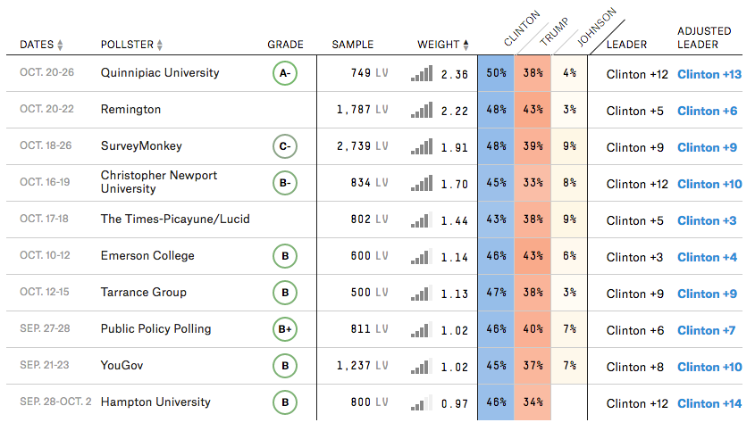
Methods
Using 2008 results
MLR
Using Polls
Simple Linear regression
Logistic regression
LOESS regression

Slide 6




Multiple Linear Regression
Dataset: results from 50 states and 1 district in 2008
Response (in %):
Democratic
Republican
Factors:
Population
MF-Ratio
Education (High school & Bachelor)
Unemployment Rate
Poverty Rate
Income (PCI)

Slide 7
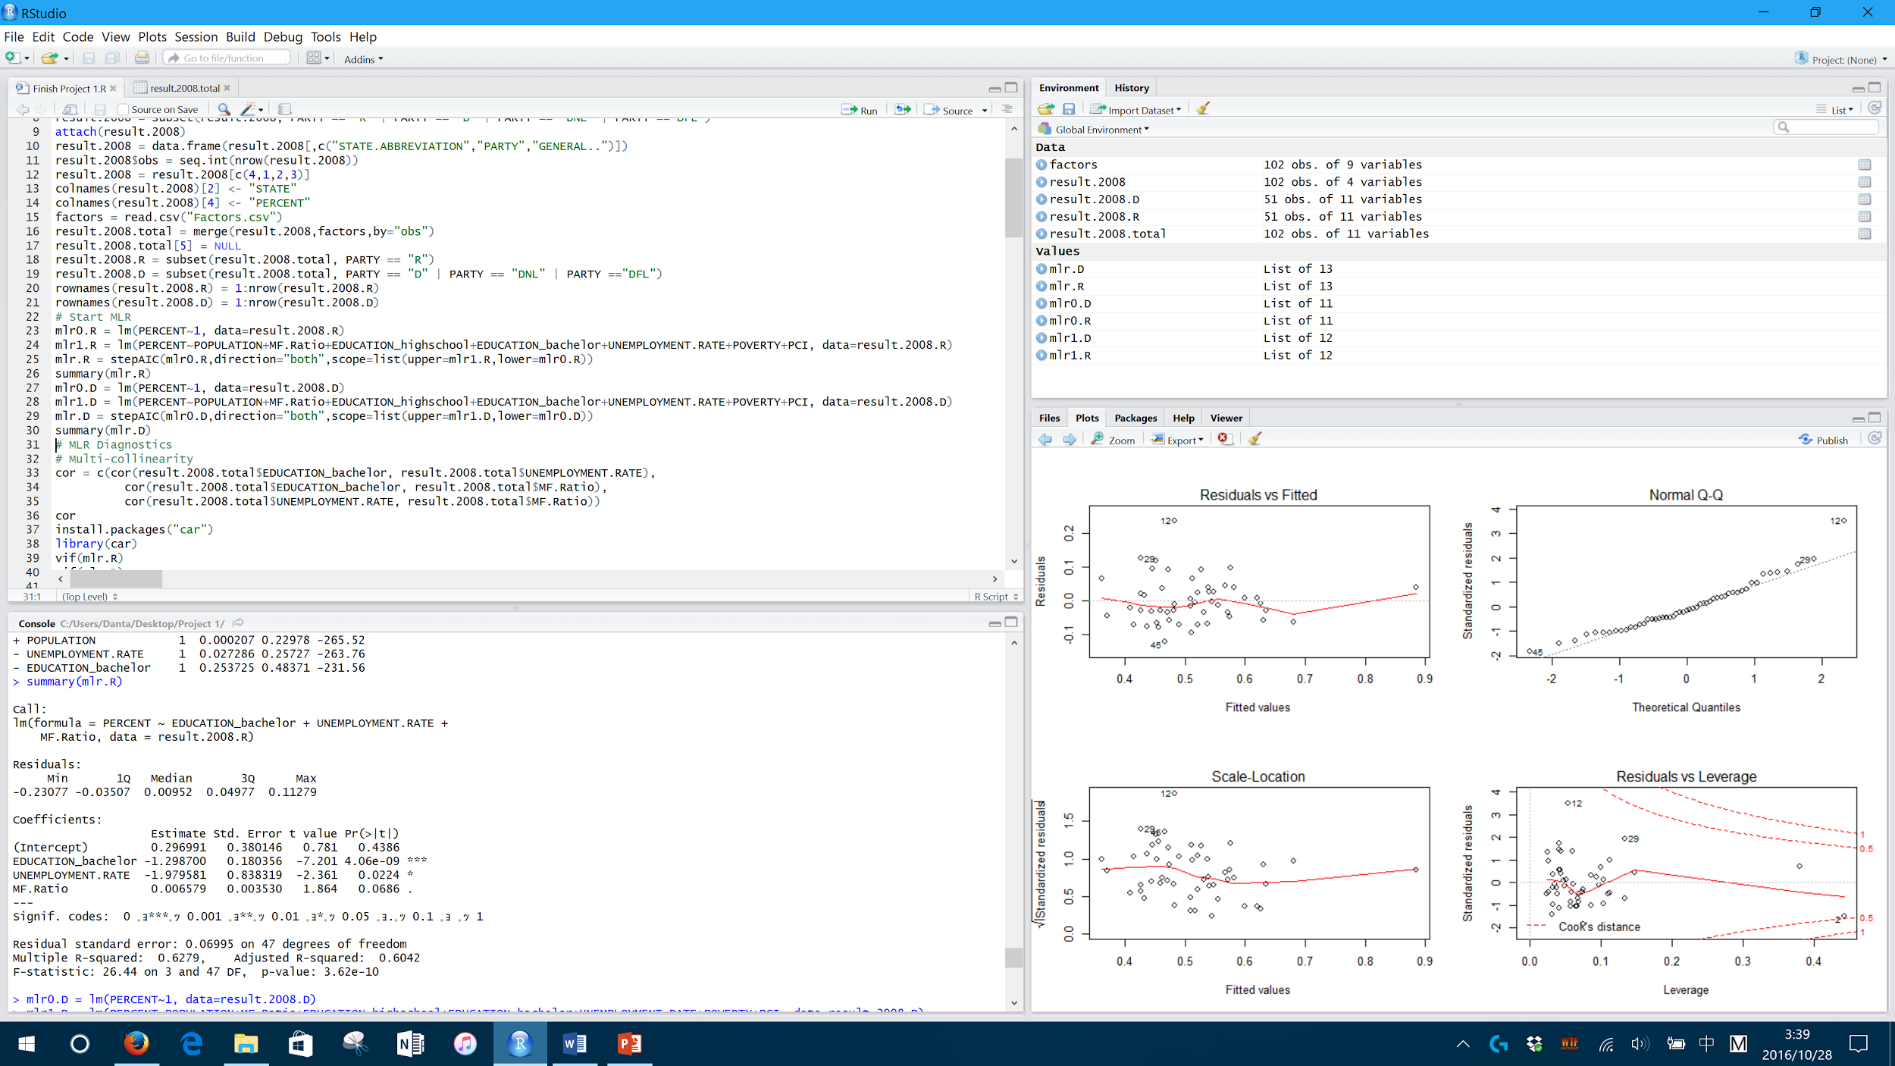
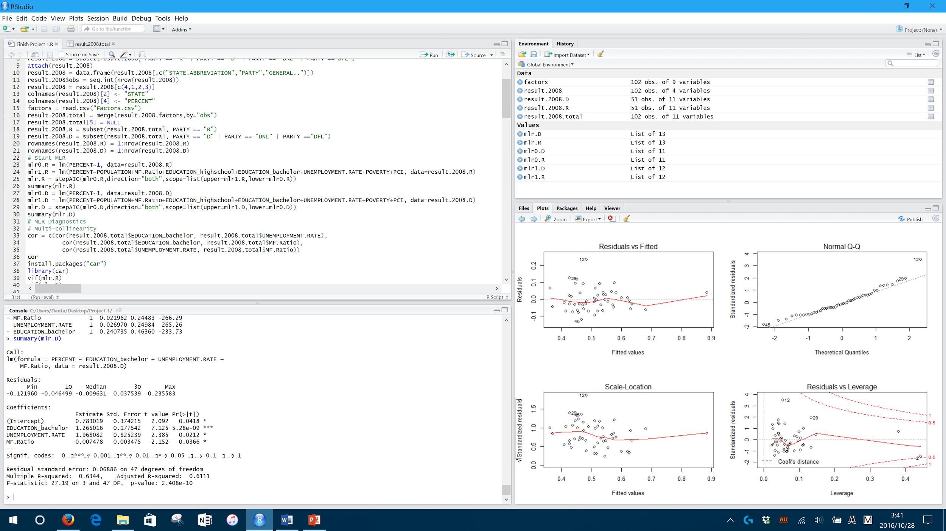
StepAIC 2 models

Slide 8
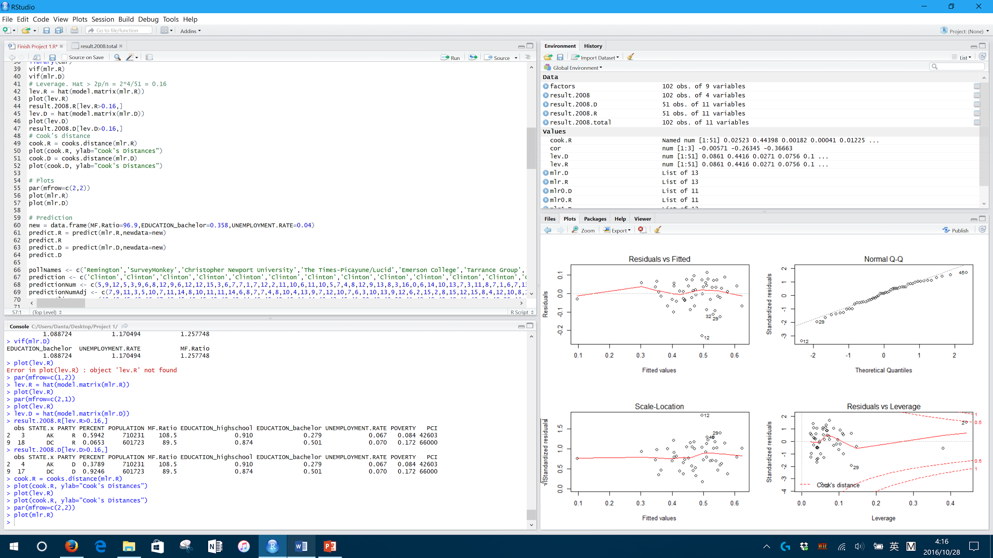
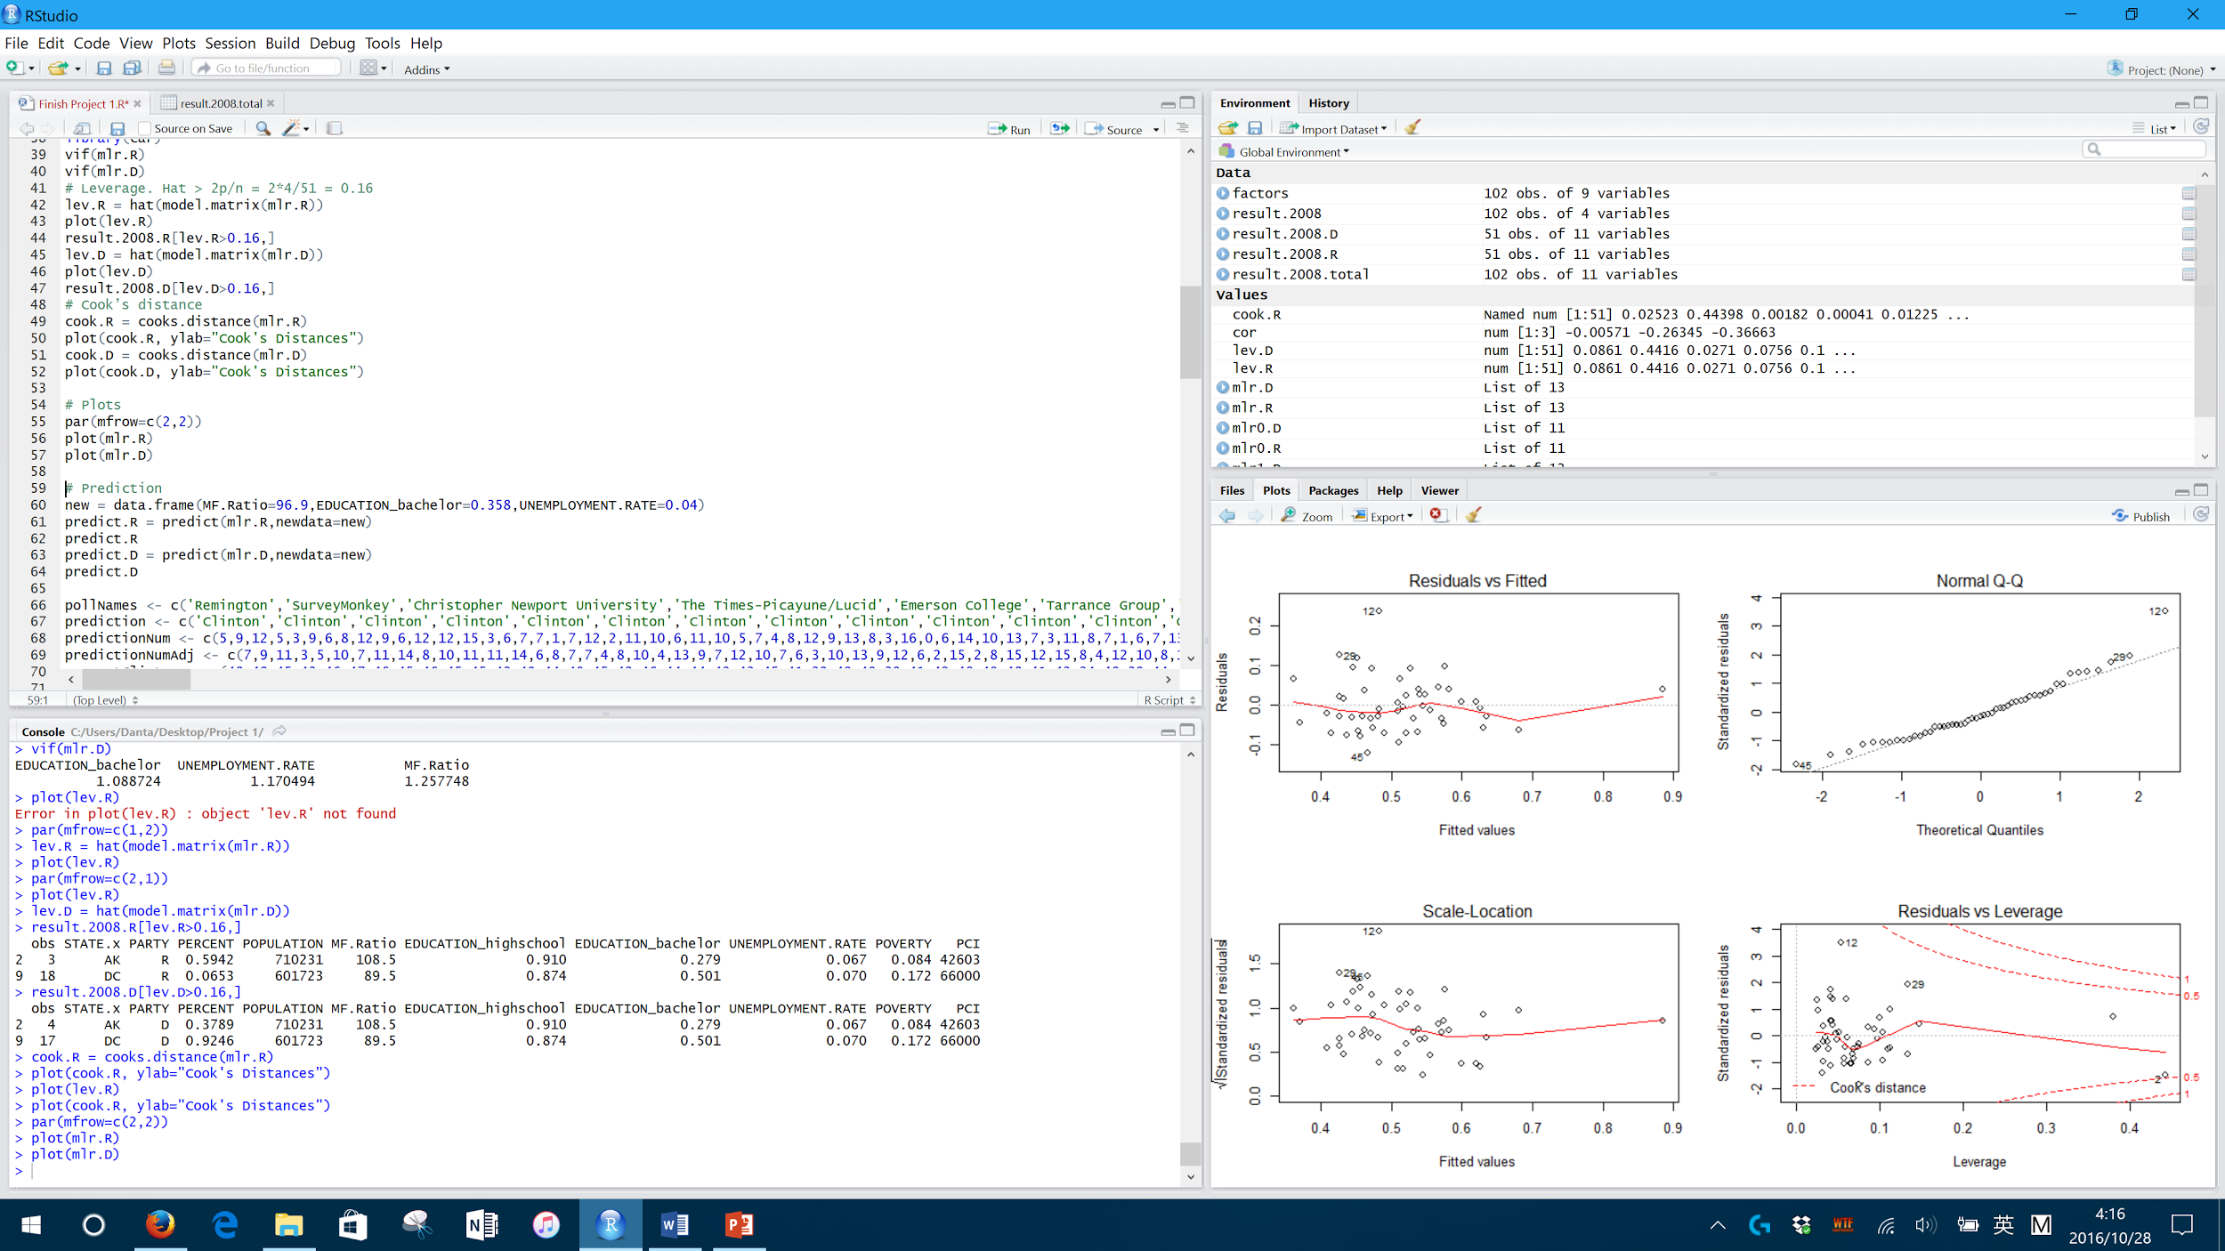
Plots

Slide 9
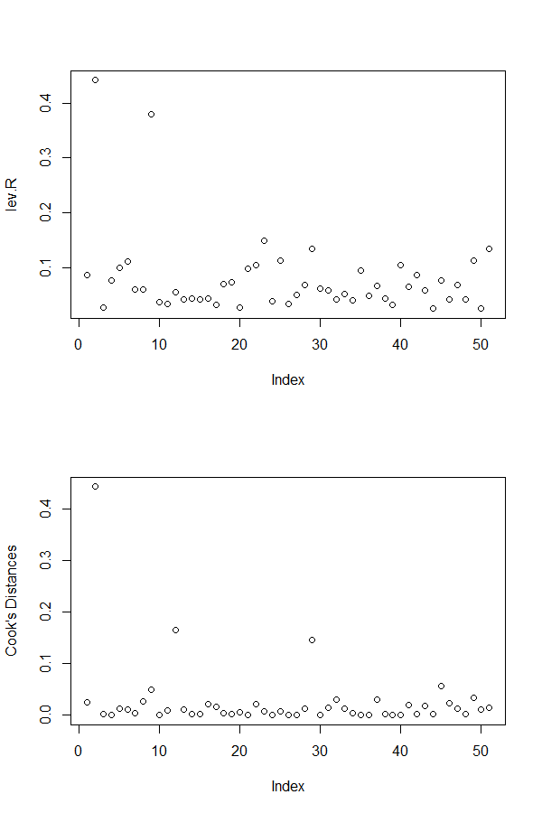
MLR Diagnostics
No Multi-collinearity
All correlations < 0.9
All VIFs < 10
Two Leverage Points
No Cook’s D Influence

Slide 10
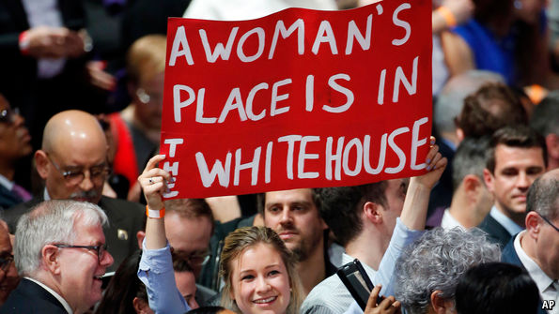
Potential Problems
Two leverage points
Data are not exactly from 2008 or 2016
M-F Ratio: greater influence？

Slide 11
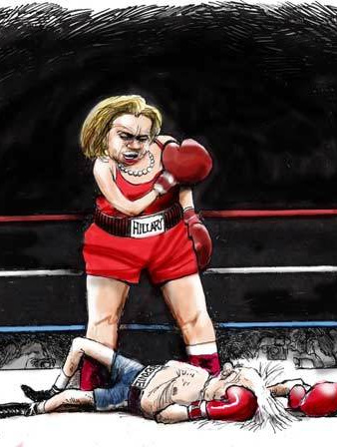
Prediction 1
Hillary Clinton: 59%
Donald Trump: 39.04%
Others: 1.96%

Slide 12
Methods
Using 2008 results
MLR
Using Polls
Simple Linear regression
Logistic regression
LOESS regression

Slide 13
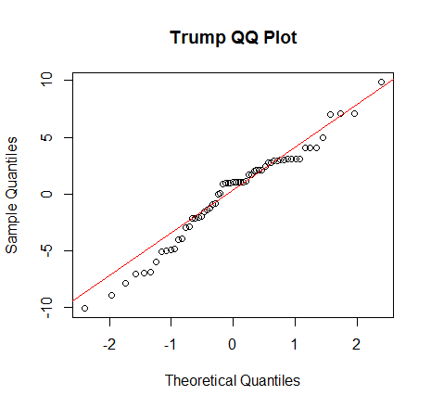
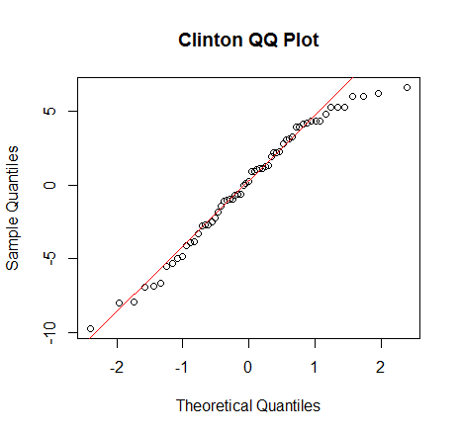
Simple Linear Regression
Started with basic linear regression
Notes:
All graphs are about residuals
See if residuals are normally distributed

Slide 14
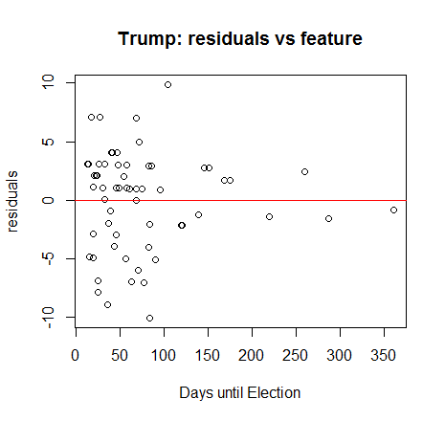
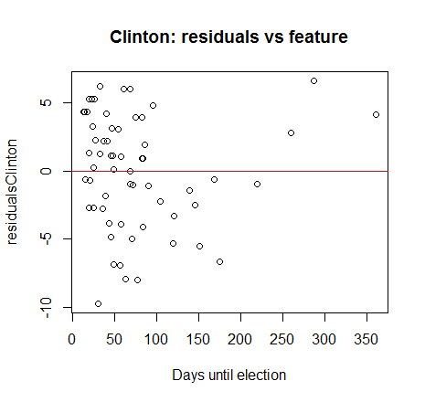
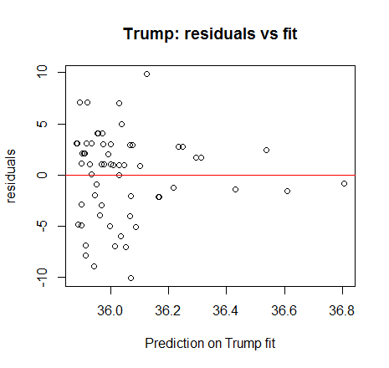
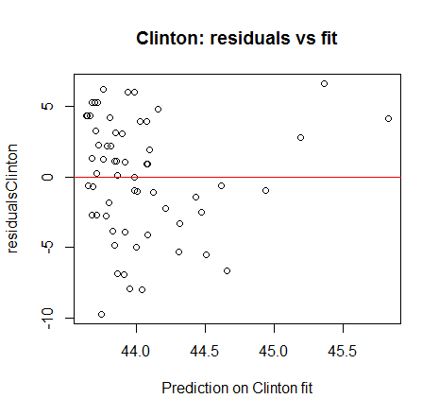
Residuals
We could remove the outliers past 150 days, because these have little influence
Linear model not Ideal for our purposes
Trump: R^2 = 0.001893
Clinton: R^2 = 0.01081

Slide 15
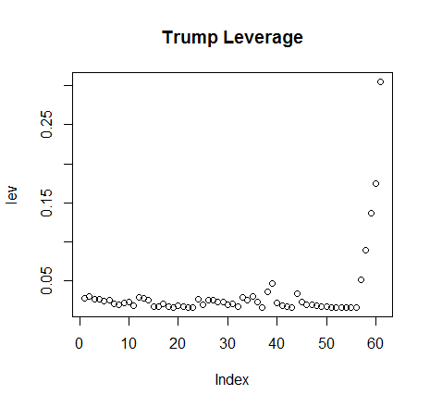
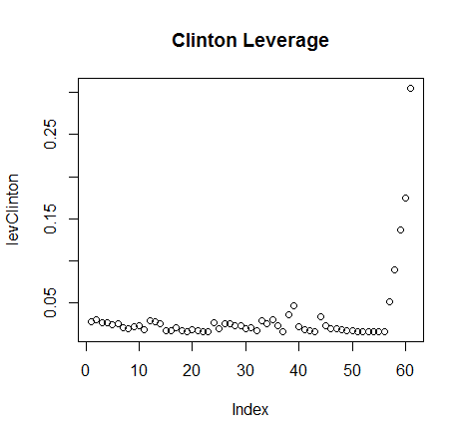
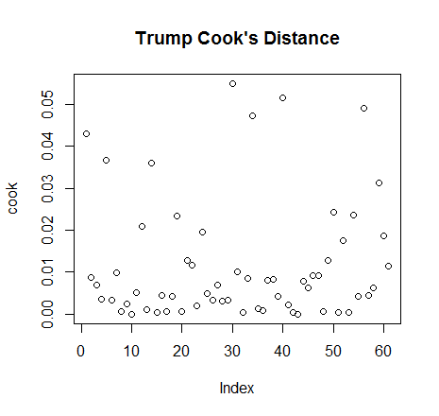
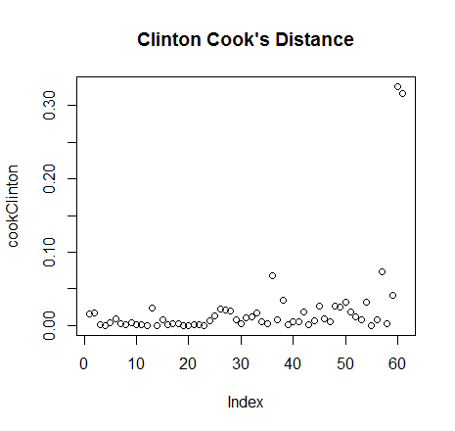
Outliers
“daysTill” is the days from the end of the poll until election day
Most fall well below .05, strong outliers(such as top right) should be investigated
These don’t ruin the model
Trump hard to predict
Notes:
Could investigate each point for Trump, and evaluate if close to a Trump scandal/after a debate/other gaff

Slide 16
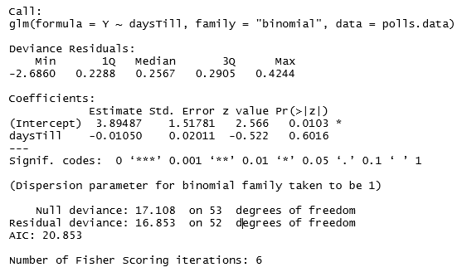
Logistic Regression
Logistic Regression Results

Slide 17
Logistic Regression
Equation:
f(x) = 3.89487 - 0.01050 * daysTill
It is 25 times more likely that Clinton will win the election, no matter what day it is
Notes:
We used logistic regression to find who was predicted to win in each poll
In this model, Trump is represented with 0’s, and Clinton is represented with 1’s
Box: “All models are wrong; some can be used.”
Each model used gets closer to a good model to represent data
Model did not fit parameters, but it does provide a prediction of who would win Virginia
This model can be used as the deviance residual is lower than the null deviance
This model did not predict the population voting percentage, but it gives a clue as to who will win Virginia
This model can be interpreted as a guaranteed victory for Clinton
This agrees with Nate Silver’s prediction of a Clinton victory (93%)
The 99% is a result of removing polls taken from a date that was 150 days or earlier than the election
If we had more time, we would have weighed the polls as not all polls are created equally
Earlier polls vs. later polls
Polls with more responses vs. polls with less responses

Slide 18
Loess Regression
Local Polynomial Regression
Non-parametric technique
Relaxes linearity assumption in LR
Assumptions
e ~ N(0, sigma^2)
X estimate by polynomial regression by nearby points
Window width, type of regression, weights affect bias and variance
Interpretation
Not interested in parameters but in fit (R^2)

Slide 19
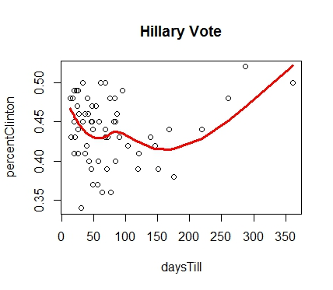
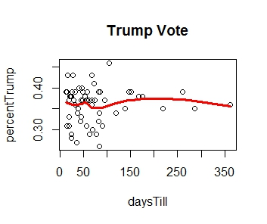
Loess Regression: Fit
Hillary Psuedo R^2: 0.9929
Clinton by 49.33%
Trump Psuedo R^2: 0.9873
Trump by 37.86%

Slide 20
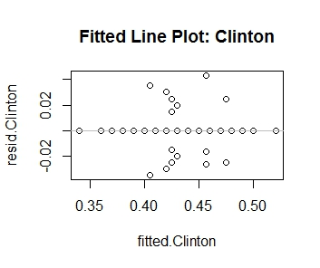
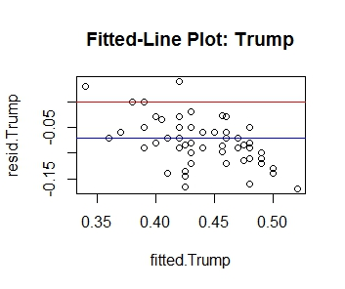
Model Validation
Same diagnostics as before with errors
Definite pattern with Clinton
Mean Error near -0.07
Solution
Lowess (Weighted Loess)
Model-Prediction + Residual Adjustment

Slide 21
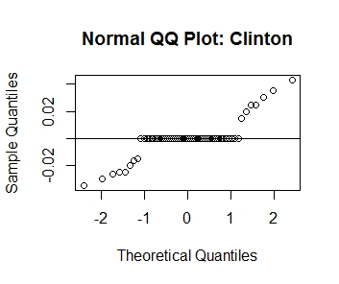
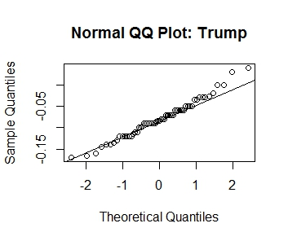
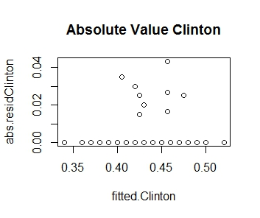
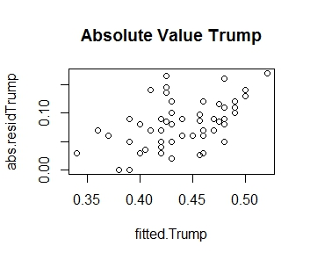
Model
Validation
(cont’d)
Model shows outliers
Could be scandals affecting polls
Residuals show model fit for Trump

Slide 22
Prediction 2
Hillary Clinton by 49.33%
Donald Trump by 44.86%
Margin of Victory: 4.47%

Slide 23
Final Prediction: MLR*(.20) + Loess*(.80)
Hillary Clinton: 51.26%
Donald Trump: 43.70%
Margin of Victory: 7.56%

Slide 24
Future
Focus on obtaining weights for Loess Regression
Not all Polls are created Equal
Explore different window widths other than R default
Look at demographic data from polls
Explore simulations using Rejection Sampling (MCMC)

Slide 25

Questions?

